Slide 1
Accounting Outsourcing Services

Slide 2
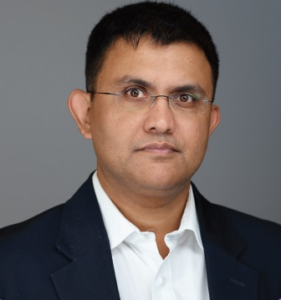
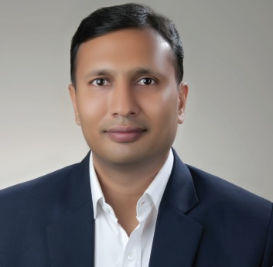
Trusted Outsourcing Partner since 11 Years
For Bookkeeping, Payroll & Tax Services
We are a true sourced accounting department providing highest level of accounting and bookkeeping expertise and access to the latest technologies.
Kshitij Jain
FCA, Director
Certified QB & Xero Advisor
Manish Jindal
FCA & DISA, Director
Certified QBO & Xero Advisor
www.mindspaceoutsourcing.com
© Copyright 2021 Mindspace All rights reserved

Slide 3
MINDSPACE- INTRODUCTION
Founded in year 2008 with an aim to provide value added Financial Outsourcing Solutions to Accounting Firms. We have domain expertise in US, UK, Australian and Ireland Bookkeeping, Financial Process & Payroll.
We are a client centric organization and our Value proposition is Knowledge Based Approach, Quality Deliverables leading to a effective Value Based Outsourcing.
We are serving our services in US, UK, Australia, and Ireland. We believe even routine accounting and bookkeeping functions deserve special treatment. We seek to enhance the business performance to our clients.
www.mindspaceoutsourcing.com
© Copyright 2021 Mindspace All rights reserved

Slide 4
SERVICE PORTFOLIO
Bookkeeping Services
VAT Return Preparation
Tax Return Processing
Payroll Processing
Accounts Production
Xero/QBO Migration
Management Reports
Sales Tax Return Preparation
GST | BAS Returns
Financial Analysis & Forecasting
IFRS and Ind –AS Implementation Support Services
www.mindspaceoutsourcing.com
© Copyright 2021 Mindspace All rights reserved

Slide 5
SERVICE PORTFOLIO
Process Outsourcing Services
Purchase To Pay Process
Invoice to Cash Process
Warranty Reconciliations and Verifications
Virtual Support service
www.mindspaceoutsourcing.com
© Copyright 2021 Mindspace All rights reserved

Slide 6
SOFTWARE WE USE
For Bookkeeping/VAT Preparation
QuickBooks Pro/QBO/QB Enterprises
Sage Line/Sage 300
VT Transaction
ClearBooks
Kashflow
Intact
Xero
SAP
Year End Accounts/Tax Returns
VT Final Accounts
DIGITA
CCH Accounts Production
Drake
Taxcalc
Pro Series
Ultra Tax
IRIS
www.mindspaceoutsourcing.com
© Copyright 2021 Mindspace All rights reserved

Slide 7
INDUSTRIES WE HAVE WORKED FOR
Accounting firms
Real Estate, Rental and Property Management Companies
Ecommerce Companies
Retail Chains (Dunkin Donuts/Burger King)
Travel Companies
Restaurants
Manufacturing Companies
Web Design & IT Companies
Law Firms
Hospitality
Automobile Dealers
Financial Services
www.mindspaceoutsourcing.com
© Copyright 2021 Mindspace All rights reserved

Slide 8
CLIENT COUNTRY SERVED
US
UK
Canada
AUS
New Zealand
Ireland
UAE
Nigeria
Qatar
Israel
Switzerland
www.mindspaceoutsourcing.com
© Copyright 2021 Mindspace All rights reserved

Slide 9
INTERNATIONAL CLIENTS
www.mindspaceoutsourcing.com
© Copyright 2021 Mindspace All rights reserved

Slide 10
INDIA CLIENTS
www.mindspaceoutsourcing.com
© Copyright 2021 Mindspace All rights reserved

Slide 11
MANAGEMENT LEVELS
Director Operations
Team Leader: Taking Care of Client on boarding and communication, tam management and team handling
Senior Process Associates: Review and Quality Checks.
Process Associates: Responsible for Data Inputting & Query Preparation.
www.mindspaceoutsourcing.com
© Copyright 2021 Mindspace All rights reserved

Slide 12
WHY MINDSPACE
Domain Expertise - The Team working on client projects are well versed with US & UK GAAP’s, US Payroll and Sales & Use Tax Laws.
Standard Processes - End to End Process gets migrated only after approved SoP’s, prepared by MindSpace and approved by Client Firm. We adhere to SLA’s and deviations are reported to the Client.
Confidentiality - Work is done under secured environment and SLA’s are adhered. Physical, Network Security and Employee Security standards are followed. We work under NDA’s.
Good Communication Skills - The Team Leaders & Director Operations are responsible for voice communication with clients. Clients can directly contact them and discuss issues.
Control of Process - The Clients keep control on the whole Outsource Accounting Processes.
Flexibility to clients - MindSpace Keeps adequate bench strength to address issues to Staff Turnover and Skewed works at the time of Month End.
Cost Savings more than 50%.
www.mindspaceoutsourcing.com
© Copyright 2021 Mindspace All rights reserved

Slide 13
INFRASTRUCTURE
10000 sq ft working space
Two lease line connections having 40 Mbps online connectivity.
Secured FTP for Data Transfers, Biometric Access and CCTV’s
24/7 Power Back up mechanism.
Different means of communication are available- Skype, US & UK Phone, Zoom, Hangout
Provision for 100% data redundancies.
www.mindspaceoutsourcing.com
© Copyright 2021 Mindspace All rights reserved

Slide 14
SECURITY
Mindspace has 3 tier security levels:
Physical Security
Work Station & Network Security
Employee Credibility and BackGround Checks
www.mindspaceoutsourcing.com
© Copyright 2021 Mindspace All rights reserved

Slide 15
ENGAGEMENT MODELS
www.mindspaceoutsourcing.com
© Copyright 2021 Mindspace All rights reserved

Slide 16
CONTACT US
Mindspace Outsourcing Service Pvt. Ltd.
London Office :
Suite LP26431,
20-22 Wenlock Road, London, N1 7GU
Phone : +44-207-096-0555
USA Office : 99 Wall Street #1379, New York, NY-10005
Phone : +1-786 - 871-2066
India Office :
247, Manish Mansion, Frontier, Adarsh Nagar, Jaipur, Rajasthan-302004
Phone : +91-141- 402-3431
info@mindspaceoutsourcing.com
www.mindspaceoutsourcing.com
info@mindspaceoutsourcing.co.uk
www.mindspaceoutsourcing.co.uk
www.mindspaceoutsourcing.com
© Copyright 2021 Mindspace All rights reserved

